Slide 1
3.02 Apply Properties Associated with the Controls
Computer Programming I

Slide 2
Essential Standard and Objectives
Essential Standard- 3.00- Apply Procedures To Construct Windows Form
3.02 Apply Properties Associated with the Controls (3%)

Slide 3
Form Control
Every application will have at least one form which is automatically included.
A form is a graphical object that contains a title bar, a system menu and minimize, maximize and close buttons.
The project Design window displays the Form object. Click to select.
A selected object displays handles that appear as squares.
You can drag a side handle to change the size.

Slide 4
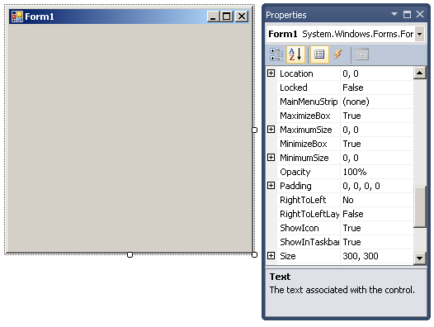
Form Control
The properties of the Form object define its appearance, behavior, position and other attributes.
To set a property value
Type or select a new value in the Properties window.

Slide 5
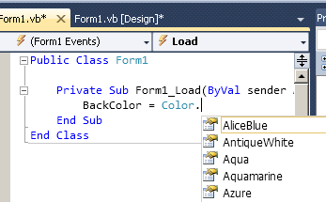
The Form Control
Form Control Properties
Name
Text is displayed in the title bar on top.
BackColor changes the color of the form background
Set the properties in the Properties window or during runtime.
Ex: BackColor = Color.Azure

Slide 6
The Label Control
The label allows you to display information or prompt the user.
Label Control Properties
(Name) should begin with lbl (lblPrompt).
Text is the text displayed in the label.
Font defines the font name, style, and size of the label text.
Autosize sizes the label to fit its text. Can be set to False so that the label size does not change.
TextAlign sets the alignment of the text within the label.
Set the properties in the Properties window.

Slide 7
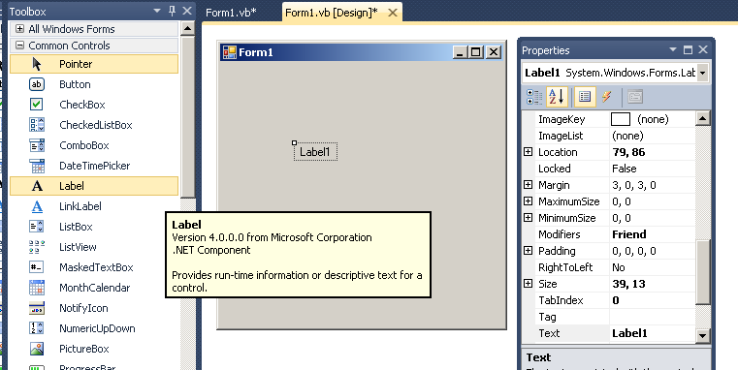
The Label Control

Slide 8
Assignment Statement uses =
Assignment Statement = MOVES data from right to left!! It is NOT equality.
lblMessage.Text = “Smile”
This statement moves the “Smile” data into the text property of lblMessage and thus shows on the form.

Slide 9
Assignment Statements Uses
Used in a procedure (Button click) to change a value at run time (Move it to the left).
Can set an object property (Text) at run time.
Form of statement
Object.Property = Value
Object is the control object’s name (lblMessage)
Property is the name of the property for the object (Text)
Value is valid property setting (“Smile”)
lblMessage.Text = “Smile”

Slide 10
Using the Label Control VB
You will use the label to display a message, information or a prompt. This is output to user and shows on the form.
Strings must be in double quotes. Ex: “Smith”
Numbers can just be written and will calculate before moving to the label . Ex: 5 + 3
Syntax for a label lblName.Text = “message/info/prompt here”

Slide 11
Combining multiple strings
Strings can be combined from several different sources. This is called concatenation.
Use & in between each segment. Spaces must surround the &.
lblAnswer.Text = “Some data “ & “ Some more data” & “ Third data”

Slide 12
Adding to the existing data in a label
Repeat the lblAnswer.Text on the right of the = to ADD ON to the existing data instead of replacing it!
lblAnswer.Text = lblAnswer.Text & “Some data to add on”
A short form of this code is below. Try both when you really understand the long form above.
lblAnswer.Text & = “Some data to add on”

Slide 13
Moving to the next line - VbCrlf
To put your message on multiple lines, add vbCrlf using the & to join the “pieces”
The vbCrlf is built into Visual Basic and moves the text to the next line (like hitting enter) lblInfo.Text = “message” & vbCrlf & “info”

Slide 14
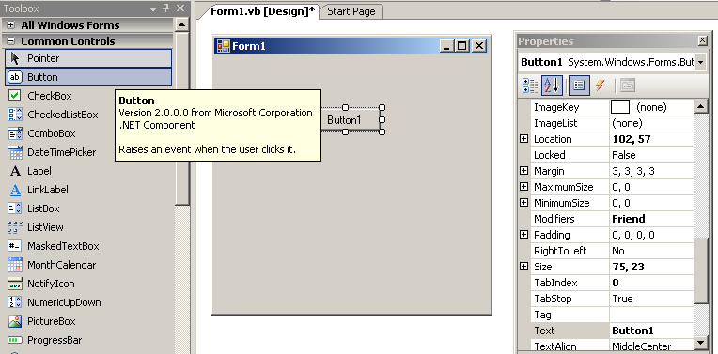
The Button Control
Button control properties
(Name) should begin with btn (btnComplete)
Text – text displayed on the button

Slide 15
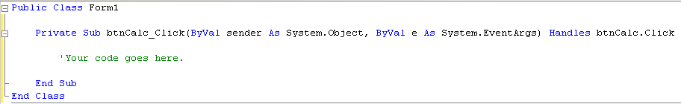
Using the Button Control
A Click event is usually coded for a Button object.
The object.method (btnCalc.click) after the “Handles” is the connection to the form.
This code will run when btnCalc is clicked during runtime.
The same object.method(btnCalc.click) after the “Sub” does NOT matter and can be changed without affecting when this code runs.

Slide 16
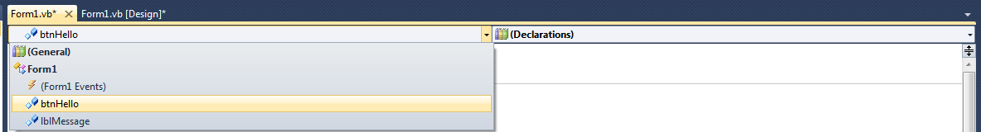
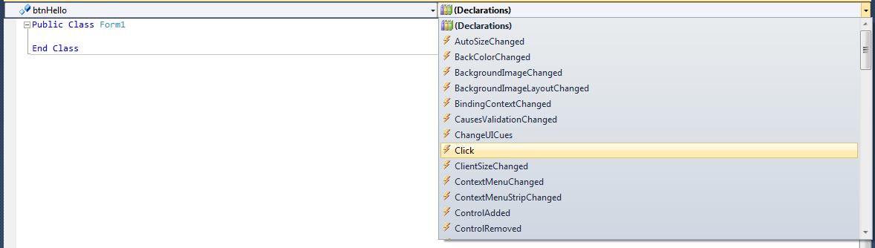
To Create a Button Click
Double click the button – or –
Open the code editor window.
Select the button from the class name list
Select the Click from the method name list

Slide 17
The CheckBox Control
Allows user to select options.
Can select more than one option.
Properties
Name – identifies the control – prefix is chk
Text – text displayed next to the box
Checked – True or False (will change to True when clicked and checkmark shows, changes to False when clicked and checkmark is removed). Can be set in properties window and also at runtime.
Can be placed in a GroupBox (add GroupBox before adding Checkboxes)
Placing in a GroupBox ties the CheckBoxes together.

Slide 18
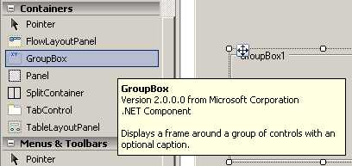
The GroupBox Control
The GroupBox is in the Containers area of the Toolbox.
Properties
(Name) should begin with grp (grpCookies)
Text – text displayed at the top of the box

Slide 19
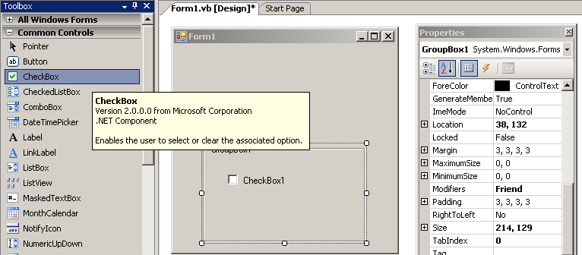
The CheckBox Control

Slide 20
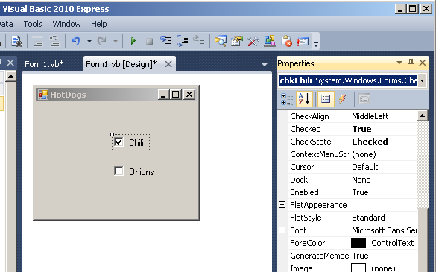
Checked Property
A checkmark shows when the Chili.Checked property is set to TRUE.
The Onion.Checked property by default is set to FALSE so no checkmark shows.
During runtime, clicking on the checkboxes will both change the property and show the checkmark..

Slide 21
Using the CheckBox Control
You can use a CheckBox in several ways.
Click Event
CheckChanged Event
Checked Property
We will use this in the decision unit(4.00) later to determine which checkbox was chosen.
You can create a CheckBox Click event the same way you created the Button Click.
To create a CheckChanged event, you will need to select the method from the code editor window.

Slide 22
The RadioButton Control
A group of radio control buttons is often used in an application to enable the user to choose from a set of options.
Only one radio button can be selected at any time.
RadioButton control properties
(Name) Should begin with rad (radChocChip)
Text the text displayed next to the button
Checked set to either True or False to display the radio button as selected or not selected.

Slide 23
The RadioButton Control
RadioButtons also use the GroupBox container.
Put your GroupBox on the form first, then add the RadioButtons.
If you do not, the user will be able to select more than one radio button.
Add the RadioButton objects by clicking the RadioButton control, then clicking the group box.

Slide 24
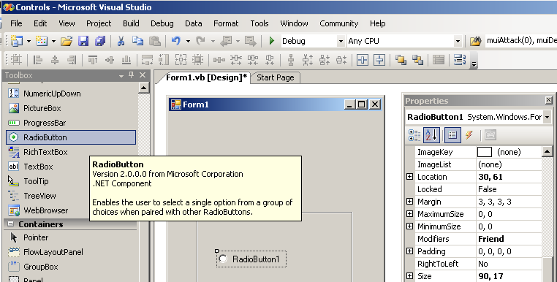
The RadioButton Control

Slide 25
Using The RadioButton Control
You can use a RadioButton in several ways.
Click Event
CheckChanged Event
Checked Property
We will learn more about this property later
You can create a RadioButton Click event the same way you created the Button Click.
To create a CheckChanged event, you will need to select the method from the code editor window.

Slide 26
Using Controls Examples
Open a new Project called example.
Add the following Controls
Button – btnHello
Label – lblMessage
Create a button click event for your btnHello
Add the code to display the message “Hello” in the lblMessage label lblMessage.Text = “Hello”
Note
Your string must be in the double quotation marks.
You must write the statement

Slide 27
Using Controls Examples
Add a GroupBox – grpChoices
Add the following RadioBoxes
radEnglish
radFrench
radGerman
Add the following messages in Click events for each.
radEnglish_Click lblMessage.Text = “Hello”
radFrench_Click lblMessage.Text = “Bonjour”
radGerman_Click lblMessage.Text = “Guten Tag”

Slide 28
Using Controls Examples
Change your RadioButtons to CheckBoxes.
Use the same messages.

Slide 29
Additional Controls
We will add additional controls during this course.

